Slide 1






Slide 2
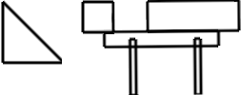
Secondary block
Revolute joints
Primary block
Swing arm
Ramp
Legs

Slide 3

















$$x_{4}x_{3}x_{2}x_{1}x_{0}+y=z_{4}z_{3}z_{2}z_{1}z_{0}$$
$$x_{4}$$
$$x_{3}$$
$$x_{2}$$
$$x_{1}$$
$$x_{0}$$
$$y$$
$$x+y=z$$
Bit Add
$$x$$
$$y$$
Bit Add
Bit Add
Bit Add
overflow
$$z$$
$$x∧y$$
$$x⨁y$$
Bit Add
Bit Add
overflow
$$z_{4}$$
$$z_{3}$$
$$z_{2}$$
$$z_{1}$$
$$z_{0}$$

Slide 4


(a)
zero
(b)
(c)
one
(d)
(e)
(f)
(g)
zero carry one
(h)
zero

